Slide 1
SE-3002 Software quality engineering
Part II-Software Testing
Functional Testing
Lecture # 19, 20, 21

Slide 2
Today’s Outline
State Transition Testing
Domain Analysis Testing
Use- case Testing

Slide 3
State Transition Testing
It allows the tester to view the software in terms of its states.
The states of the system or object under test are separate, identifiable and finite in number.
A state table shows the relationship between the states and inputs,
and can highlight possible transitions that are invalid.
Tests can be designed to cover a typical sequence of states, to cover every state, to exercise every
transition, to exercise specific sequences of transitions or to test invalid transitions.

Slide 4
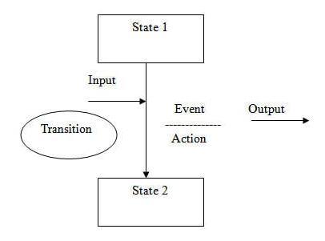
State Transition Testing
state transition model has four basic parts:
The states that the software may occupy.
The transitions from one state to another.
The events that cause a transition.
The actions that result from a transition.

Slide 5
State Transition Testing
A state is represented as a circle or oval
a transition from one state to another is represented by an arrow going with a description of the action executed,
the initial state is identified by an arrow to that state that comes from a point outside the graph
the representation of the final state is obtained by an arrow that leaves that state to reach a circle:

Slide 6
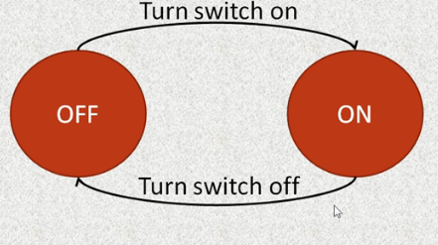
Example: light switch
States are On> Off> On

Slide 7
In the flight reservation login screen, consider you have to enter correct agent name and password to access the flight reservation application. The application allows three attempts, and if users enter the wrong password at 4th attempt, the system closes the application automatically.

Slide 8
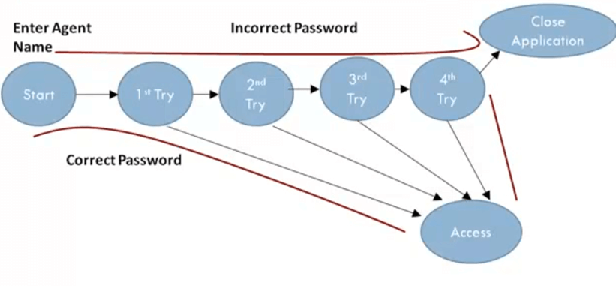
The State Graph:

Slide 9
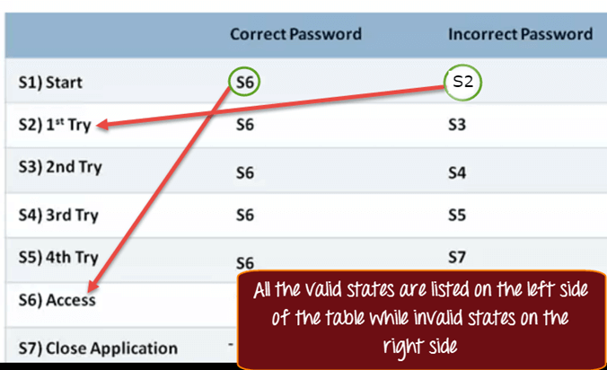
State Table

Slide 10
Practice Question
For example, a task in an operating system can have the following states:
1. New State: When a task is newly created.
2. Ready: When the task is waiting in the ready queue for its turn.
3. Running: When instructions of the task are being executed by CPU.
4. Waiting: When the task is waiting for an I/O event or reception of a
signal.
5. Terminated: The task has finished execution. And,
Transition events like admitted, dispatch, interrupt, wait etc.
Main Flow:
Task is in new state and waiting for admission to ready queue, a new task admitted to ready queue and a ready task has started running. Running task has been interrupted and now running task is waiting for I/O or event Wait period of waiting task is over. Task has completed execution.

Slide 11
Limitations and assumptions
The main assumptions with state transition testing are that we have identified all states and all transitions.
Any possible “un-identified” state or transition can lead to potential defects being left for the customer to find.

Slide 12
Domain analysis testing
A software testing technique in which application is tested by providing input data and verification of relevant output.
In domain testing, testing takes place with the minimum number of input data so that the application does not allow invalid and out of range data and evaluate the expected range of output.
Domain testing ensures that an application does not have input data outside the mentioned valid range. This testing process is used to verify the application for its ability to react or operate for different variety of input values.
Notes:
Domain testing also called equivalence testing or boundary analysis testing.

Slide 13
Strategy of Domain Testing
1. Domain Selection
Input variables that need to be assigned, and the proper result has to be verified.
2. Group the Input Data into Classes
A similar type of input data is partitioned into subsets. There are two types of partitioning, Equivalence class partitioning & Boundary value analysis (BVA).
3. Input Data of the Classes for Testing
The boundary values should be considered as the data for testing. Boundaries represent the equivalence classes more likely to find an error than the other class members.
4. Verification of Output Data
When input data is assigned to application concerning that output data verified. Output data should be invalid and specified range.

Slide 14
Example:
Consider a games exhibition for Children, 6 competitions are laid out, and tickets have to be given according to the age and gender input. The ticketing is one of the modules to be tested in for the whole functionality of Games exhibition.

Slide 15
According to the scenario, we got six scenarios based on the age and the competitions:
Age >5 and <10, Boy should participate in Storytelling.
Age >5 and <10 , girl should participate in Drawing Competition.
Age >10 and <15, Boy should participate in Quiz.
Age >10 and <15 , girl should participate in Essay writing.
Age<5, both boys and girls should participate in Rhymes Competition.
Age >15, both boys and girls should participate in Poetry competition.

Slide 16
As we discussed earlier there are two types of partitioning:
Equivalence class
BVA

Slide 17
Class 1: Children with age group 5 to 10
Class 2 : Children with age group less than 5
Class 3: Children with age group age 10 to 15
Class 4: Children with age group greater than 15.

Slide 18
Scenario | Boundary values to be taken | Equivalence partitioning values
Boy – Age >5 and <=10 | Input age = 6 Input age = 5 Input age = 11 Input age = 10 | Input age = 8
Girl – Age >5 and <=10 | Input age = 6 Input age = 5 Input age = 11 Input age = 10 | Input age = 8
Boy – Age >10 and <=15 | Input age = 11 Input age = 10 Input age = 15 Input age = 16 | Input age = 13
Girl – Age >10 and <=15 | Input age = 11 Input age = 10 Input age = 15 Input age = 16 | Input age = 13
Age<=5 | Input age = 4 Input age = 5 | Input age = 3
Age >15 | Input age = 15 Input age = 16 | Input age = 25

Slide 19
Domain Testing Structure
Identify the potentially interesting variables.
Create and identify boundary values and equivalence class values as above.
Identify secondary dimensions and analyze each in a classical way. (In the above example, Gender is the secondary dimension).
Identify and test variables that hold results (output variables).
Evaluate how the program uses the value of this variable.
Identify additional potentially-related variables for combination testing.
Summarize your analysis with a risk/equivalence table.

Slide 20
Use cases testing
Use Case Testing is a functional black box testing technique that helps testers to identify test scenarios that exercise the whole system on each transaction basis from start to finish.
Use cases are a representation of the expected behavior of a system as it should respond to the requests of users external to the system.
The level of modeling detail can vary for use cases, which usually involves transactions from initiation until termination, and includes other factors besides the system, such as sub-systems or other software applications.
The sum of all the use cases is used to describe the way the system or software works.
This is the case in agile development methods when specifications are provided in the form of use cases or user stories.

Slide 21
Cash withdrawal – use case specification
Brief Description
This use case describes how the Bank Customer uses the ATM to withdraw money to his/her bank account.

Slide 22
4 Basic Flow of Events
The use case begins when Bank Customer inserts their Bank Card.
Use Case: Validate User is performed.
The ATM displays the different alternatives that are available on this unit. In this case the Bank Customer always selects "Withdraw Cash".
The ATM prompts for an account.
The Bank Customer selects an account.
The ATM prompts for an amount.
The Bank Customer enters an amount.
Card ID, PIN, amount and account is sent to Bank as a transaction. The Bank Consortium replies with a go/no go reply telling if the transaction is ok.
Then money is dispensed. The Bank Card is returned.
The receipt is printed.
The use case ends successfully.

Slide 23
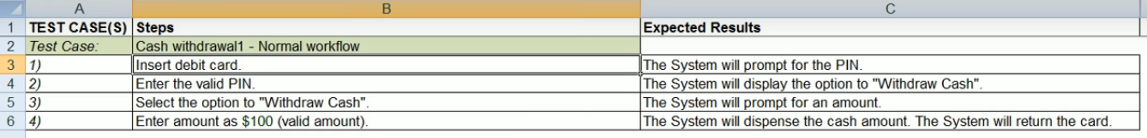
testcases

Slide 24
test cases

Slide 25
testcases

Slide 26

That is all

